Slide 1

Negative Effects of Gun Violence on the Mental Health of Youth
Haneen Alaqrabawi, Katya Garashchenko, Mariyanthie Linaris, Marckenzie Jean-Baptiste, and Medhat Nan

Slide 2
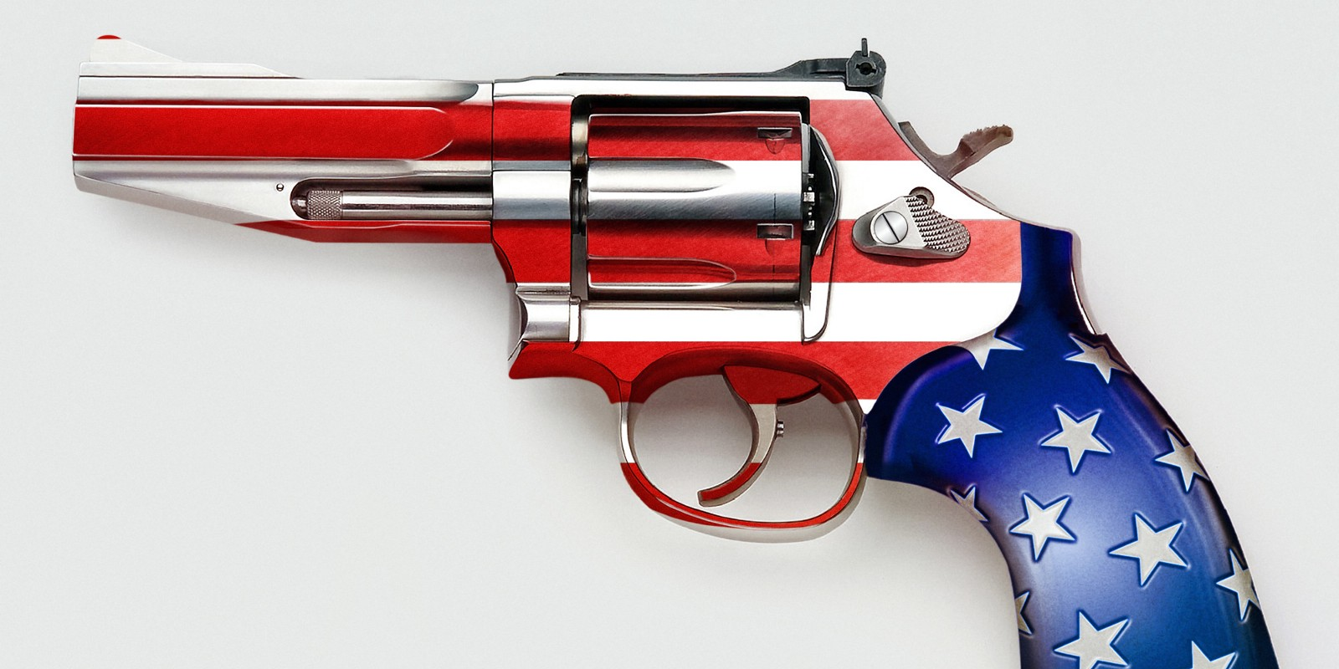
Gun Use in America- Some Statistics
Nearly 40,000 people have died from gun violence in America in 2017 alone, the largest yearly rate in 50 years (Mervosh, 2018).
Three-in-ten American adults say they currently own a gun.
For many adults who own guns, exposure to guns happened at an early age. About two-thirds of current gun owners (67%) say there were guns in their household growing up.

Slide 3

Children and Youth in Homes with Guns
It is estimated that about 4.6 million children live in homes with loaded/unsecured guns.
What is gun violence?
Notes:
Despite the prevalence of guns in the United States, an ongoing and intense cultural struggle continues regarding their proper place in society, particularly in the lives of children and youth. Most states have laws limiting minors' access to guns. Yet surveys reveal that many youth, perhaps most, believe they could obtain a gun if they wanted to. Gun violence is important to analyze because unlike other types of violence, a moment of aggression or a single mistake can become deadly very quickly.
Gun-related violence is violence committed with the use of a gun (firearm or small arm). Gun-related violence may or may not be considered criminal (accidents, etc). Criminal violence includes homicide, assault with a deadly weapon, and suicide, or attempted suicide.

Slide 4
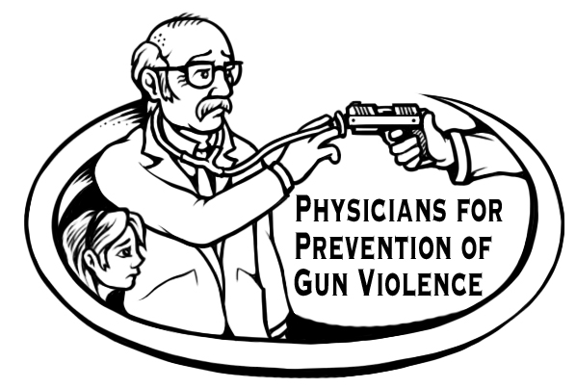
Why does gun violence matter to us as providers?
In one year on average, 2,737 kids die from gun violence and 14,470 kids survive gun injuries.
Gun violence effects more than just the physical well-being of youth.
Children and youth exposed to gun violence either towards them or those around them experience lasting mental health effects.
The medical costs associated with gun violence are high. (APHA)
Notes:
Kids may experience negative short- and long-term psycho- logical effects, including anger, withdrawal,posttraumatic stress, and desensitization to violence.
Gun violence cost the U.S. $229 billion in 2015, or an average of $700 per gun in America:
• The societal costs of firearm assault injury include work loss, medical/mental health care, emergency transportation, police/criminal justice activities, insurance claims processing, employer costs and decreased quality of life according to the American Public Health Association.

Slide 5
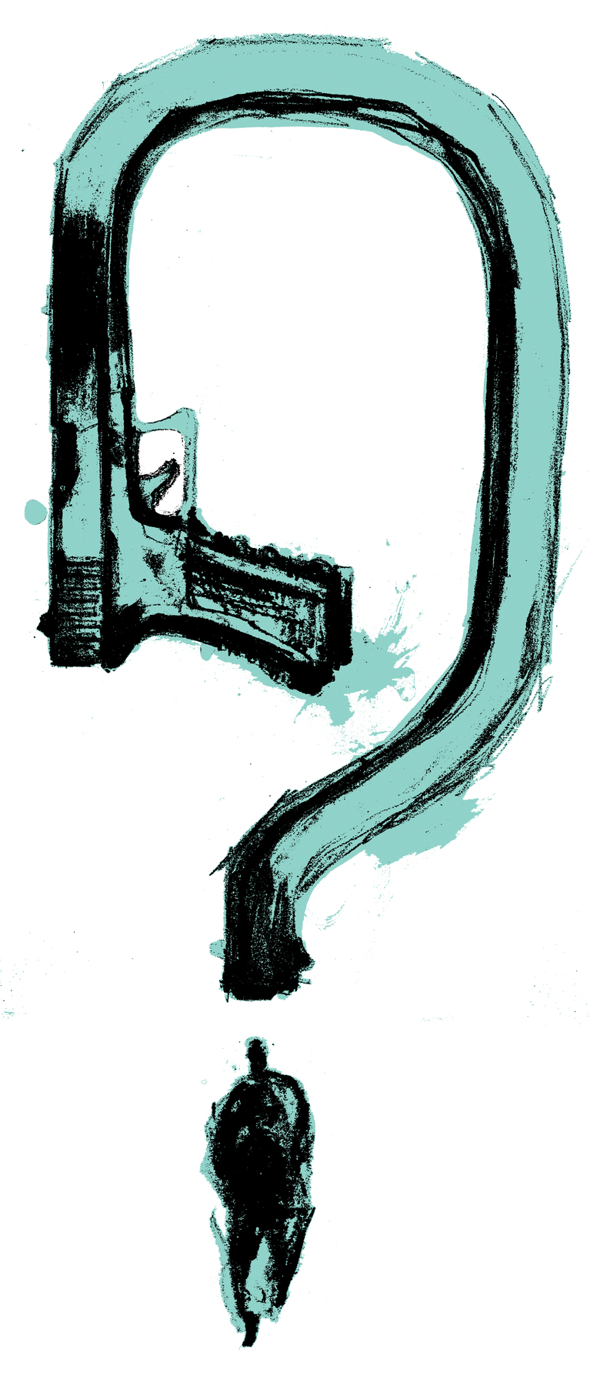
The Psychological Impacts
A study with kids 3rd-8th grade in a rural environment indicated that children exposed to gun violence reported significantly higher levels of anger, withdrawal, and posttraumatic stress disorder (Garbarino, 2002).
Wounded and violence exposed youth may experience disruptions in their relationships with their peers and family members. Some young people experience survivor guilt after witnessing violence.
Children exposed to gun violence commonly experience difficulty concentrating in the classroom, declines in academic performance, and lower educational and career aspiration.
Psychologically, exposure to violence can normalize the use of violence to resolve conflicts, leading to continuous cycle of violence.

Slide 6
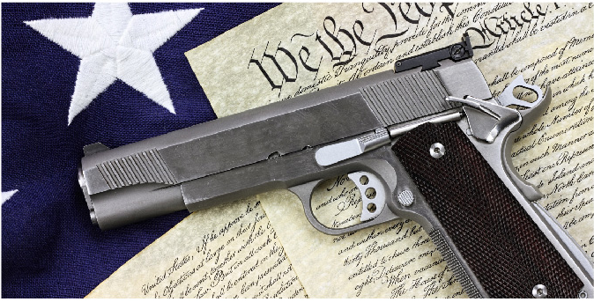
Gun Policies in the United States
Rooted in the Second Amendment:
  “A well regulated Militia, being necessary to the security of a free State, the right of the people to keep and bear Arms, shall not be infringed.”
Federal laws regulate the sale, ownership, and manufacture of firearms and ammunition.
State laws can provide extra restrictions and dictate whether open-carry is allowed in that state.
Notes:
There is a lot of debate regarding the intention of this sentiment. On one hand, there is the argument that, “a well regulated militia,” indicates Congress should not be able to take away a state’s right to self-defense. On the other hand it is argued that, “the right of people to keep and bear arms,” it is considered unconstitutional to prohibit firearm possession among individual Americans.
The way our country currently works is highlighted by the next two points.

Slide 7
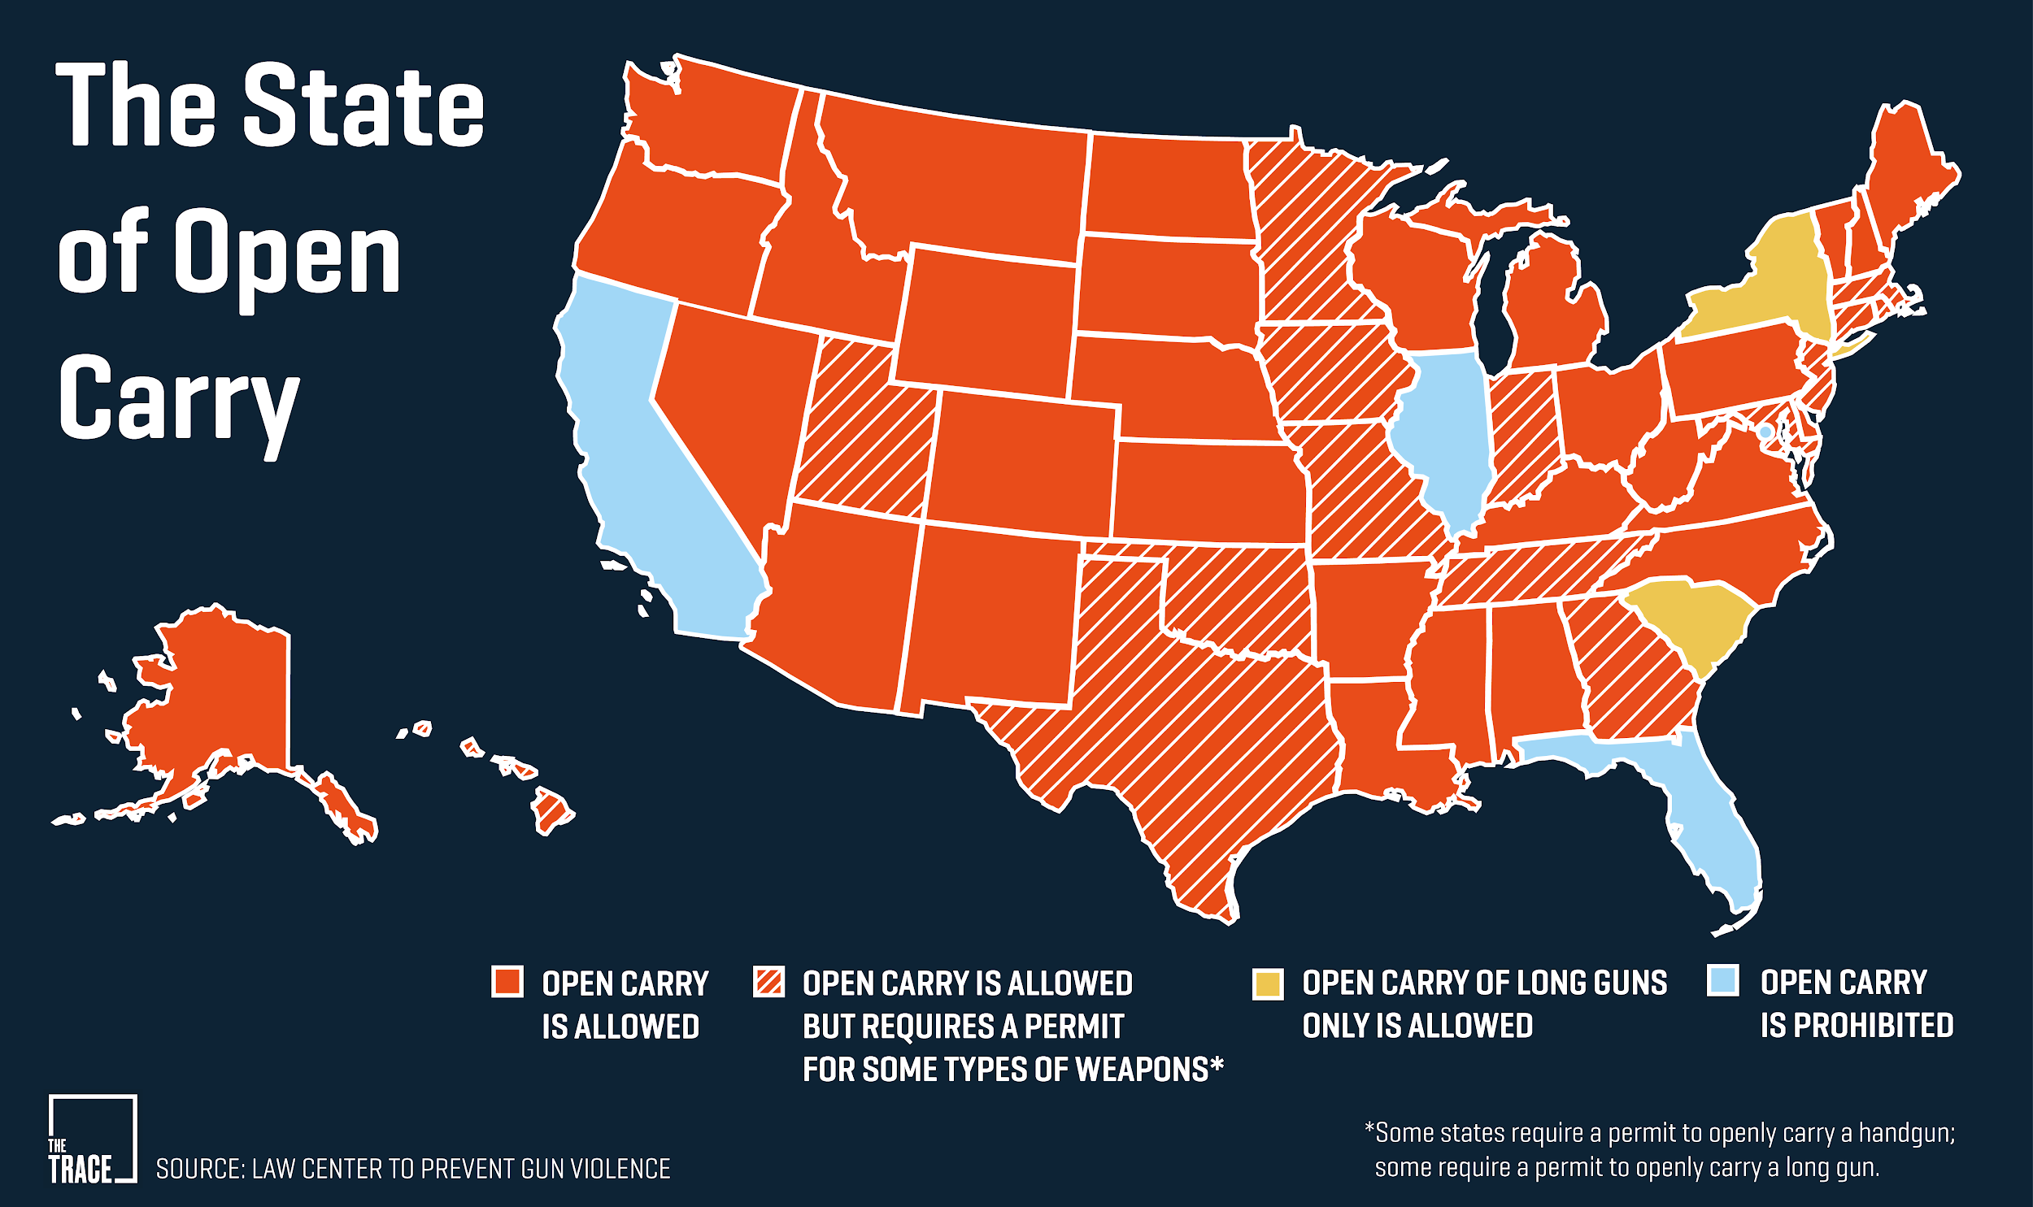
Notes:
This brings us to how gun laws are governed across the states. The term “open carry” refers to the act of freely bearing or carrying a firearm in public. As you can see, “open carry” is allowed across the majority of states, accounting for 3 million Americans carrying loaded firearms daily. Most claim the reason for this to be protection.
Non-permissive open carry states: Identified in blue, states that prohibit open carry include California, District of Columbia. Florida, Illinois
In yellow, New York and South Carolina allow open carry of long guns only
Licensed-open carry states: Striped states allow open carry with a permit: Connecticut, Georgia, Hawaii, Indiana, Iowa, Maryland, Massachusetts, Minnesota, New Jersey, Oklahoma, Rhode Island, Tennessee, Texas and Utah
Permissive open carry states: Open carry in public with no restrictions is allowed in the remaining 31 states

Slide 8
Restrictions to Open-Carry
Although many states allow open carry, there are always exceptions to the rule
Certain locations are deemed inappropriate for gun owners to carry their gun:
  Schools
  State-owned businesses
  Federal owned property
    Courthouses, buildings, prisons, military bases
    Public transportation
  Places where alcohol is served
  Specifically densely populated cities such as in Pennsylvania and Virginia
Penalties
  Up to 5 years of imprisonment
  Maximum fine of $5,000
Notes:
Carrying a firearm while unauthorized in any of these locations is considered a violation of federal law and results in severe penalty.
Penalties are highly applied in school settings.

Slide 9
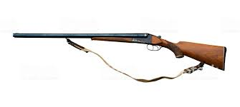

Who Can Own A Gun?
Anyone above the age of 18 can own a long gun
  Long guns are firearms with longer barrels such as shotguns or rifles
  Some states allow people as young as 14 or 16 to own long guns only if used for hunting
Anyone above the age of 21 can own a handgun
The Gun Control Act of 1968 prohibits certain people from owning firearms:
  Indicted or convicted of a felony punishable by at least 1 year of imprisonment
  A fugitive of justice
  Unlawfully using or addicted to a controlled substance
  Declared mentally defective or committed to a mental institution
  An illegal immigrant
  Dishonorably discharged by the Armed Forces
  Renounced United States citizenship
  Subject to restraining orders for harassing, stalking, or threatening an intimate partner or child
  Convicted of a domestic violence misdemeanor

Slide 10
How to Buy a Gun in the United States
Step 1: Most states require you pass two background checks implemented by the store and instant state and federal background checks
Step 2: Buy the gun
States that require permits have waiting periods between the background check and purchase
Others states do not require private sellers to conduct any form of background checks
Guns can be purchased in independent gun stores or at Walmart
Semi-automatic weapons can be bought relatively easily, but automatic weapon purchase is more restricted for civilians
High capacity magazine sales are also restricted

Slide 11
Comparing Policies in the United States to Other Countries
The United States represents 5% of the world’s population, but represents 35-50% of the world’s civilian gun ownership
  Ranks first in firearms per capita world-wide
The firearm homicide is highest in the United States compared to the rest of the world’s most developed nations
Let’s compare:
  Canada
  Australia
  Israel
  United Kingdom
  Norway
  Japan

Slide 12
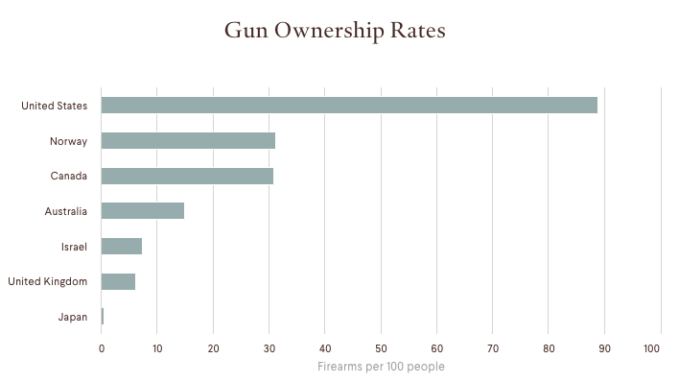

Slide 13
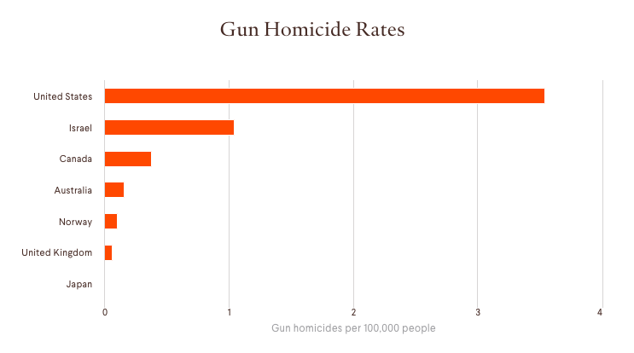

Slide 14

Gun Policies in Canada
3 classes of firearms:
  Unrestricted (rifles and shotguns)
  Restricted (handguns and semi-automatic weapons)
  Prohibited (automatic weapons)
Policies:
  More detailed background checks
  28-day waiting period between license and purchase
  Mandatory safety training courses
  Ban on large capacity magazines
  Bans on military-style weapons and ammunition
Turning Point: 1989 Montreal Mass Shooting

Slide 15

Gun Policies in Australia
National Agreement on Firearms nearly prohibits semi-automatic and automatic firearms
Mandated licensing and registration of all guns
  Licenses must demonstrate genuine need
Mandatory firearm safety course
Gun buy-back program
Turning Point: 1996 Port Arthur Massacre

Slide 16
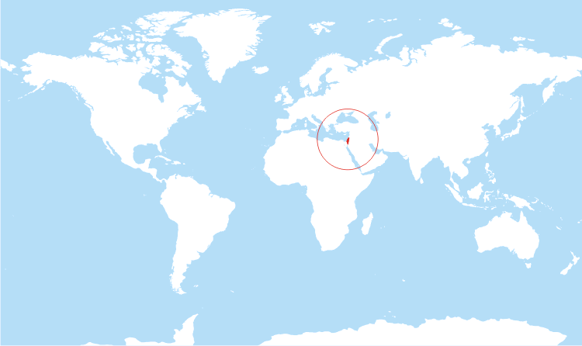
Gun Policies in Israel
Compulsory military service (2-3 years)
Psychological testing
Mandatory weapons training
Ban on assault weapons for civilians
All guns must be licensed and registered
  Strict requirements:
    Israeli citizen/permanent resident
    Speak Hebrew
    At least 21 years old
    Genuine cause

Slide 17
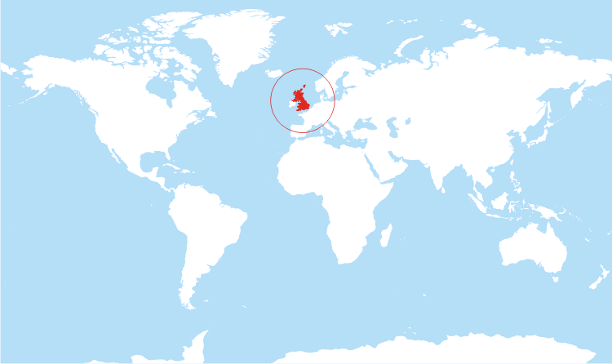
Gun Policies in the United Kingdom
Firearm (Amendment) Act
  Banned semi-automatic and automatic rifles
  Increased registration for other firearms
Handguns mostly banned
Gun buy-back program
Turning Points: 1987 Hungerford Massacre and 1996 Dunblane Massacre

Slide 18
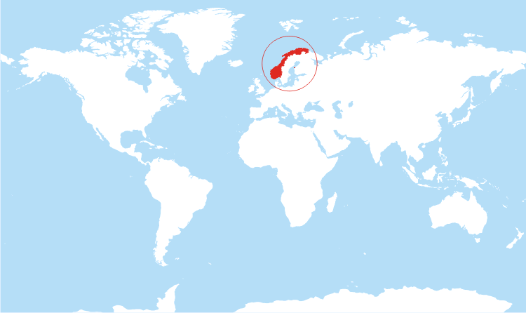
Gun Policies in Norway
Valid reason for gun ownership
Most police officers do not carry guns
Automatic weapons prohibited
Turning Point: 2011 Oslo Massacre

Slide 19

Gun Policies in Japan
Firearm and Sword Law
  All firearms except shotguns, air guns, and guns with specific industrial and research purposes are prohibited
Mandatory weapons training
Written test
Mental evaluation
Drug test
Detailed background check
Must inform government how and where weapons and ammunition are stored
Annual firearms inspection
Turning Point: World War II?

Slide 20

Barriers to Solutions for Gun Violence
on the Mental Health of Youth

Slide 21
Lack of Funding for Gun Violence Research
The 1996 Dickey Amendment- prohibited the Centers for Disease Control(CDC) from using its funds to support research that could be perceived as advocating for gun control.
– It was supported by the National Rifle Association(NRA) because they believed gun research was politically motivated and supporting anti-gun policy
Later, similar restrictions were also extended to the National Institute of Health(NHI)
This Amendment had drastic effects on the amount and quality of gun violence research that would occur after 1996
Notes:
Public health and medical professionals have been speaking up and searching for ways to help prevent gun violence. But they face an obstacle when it comes to getting funding for research. Jay Dickey, was a former congressman and Arkansas Republican who was a strong NRA ally. He died in 2017 and actually stated that he regretted the impact this law had on limiting gun violence research

Slide 22
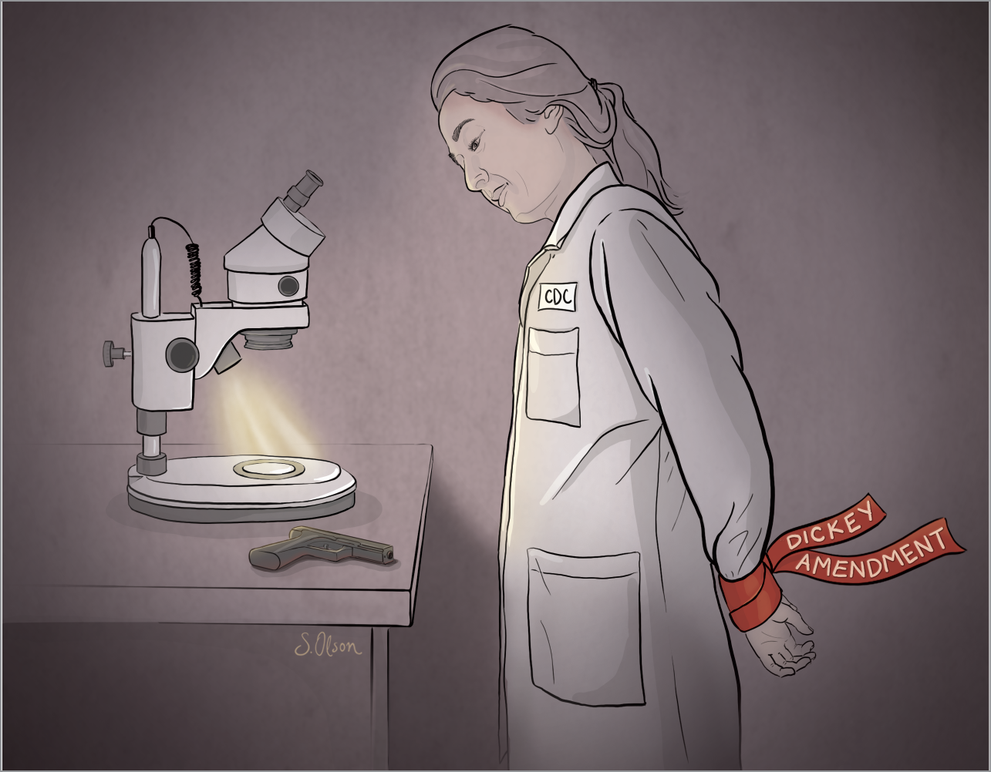
Reduced gun violence research as a
result of 1996 Dickey Amendment
CDC funding for research relating to firearms stopped.
Average annual funding for the CDC’s research on firearm injury prevention between 2009 and 2012 was 96 percent lower than the average annual funding between 1993 and 1996(2).
Today, federal agencies spend just $2 million annually on gun violence prevention — compared with $21 million for the studies about headaches.
Notes:
Reduced research leaves many questions about gun violence, prevention and risk factors unanswered. We really just have alot of data about about the number of people dying from gun violence. Alot of the qualitative data is missing. We lack in depth research about how gun violence affects mental health.

Slide 23

We need research from the CDC to better understand the association between gun violence and mental health
Private foundations have been able to help fund research but the quality of research does not compare to the great data gathering and monitoring programs that the CDC can conduct.
The CDC has elaborate data gathering and monitoring programs. We have seen this with the quality research obtained with other public health crises like Ebola or heart disease.
There are still more questions how gun violence and mental illness are related that we just don't understand.

Slide 24

Hope for Gun Violence Research-Changes to Dickey Amendment
In March 2018, Congress passed a $1.3 trillion spending bill that included a compromise on gun violence research.
Clarified that the CDC does have the authority to conduct research on the causes of gun violence.
It still prohibited the CDC and other agencies from using federal funding to advocate or promote gun control.

Slide 25
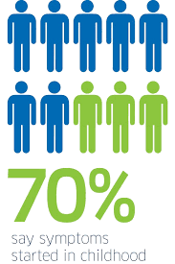
Youth with Mental Disorders do not seek out help
Approximately 1 in 5 adolescents has a diagnosable mental health disorder.
However, studies have found that most children and adolescents with mental health disorders do not seek out or receive the services that they need.
Estimated between 60 and 90 percent of adolescents with mental health disorders fail to receive treatment
61.5% of youth with major depression do not receive any mental health treatment.

Slide 26

Disparities in Youth Access to Mental Health Treatment
Black children and adolescents are least likely than Hispanic or white peers to receive outpatient treatment for depression.
Adolescent males age 16 and 17 are among the least likely to receive services.
LGBT adolescents, homeless adolescents and adolescents under child welfare and juvenile system also are least likely to receive services.
Fewer than half of rural counties have a mental health facility that provides outpatient treatment for children/adolescents and only one-third have an outpatient facility with special programs for youth with severe emotional disturbance.

Slide 27

Stigma Associated with Mental Health Disorders
Societies stigma associated with mental health disorders may discourage adolescents from seeking treatment.
A study of juvenile youth with mental disorders in detention centers showed that most believed that their problems would go away without outside help regardless of gender, race/ethnicity, or (among females) prior experience with mental health services.
This perception is also common among youth in the general population with self-identified mental health needs and among youth receiving substance use services. Parents of children with mental illness also frequently report this barrier

Slide 28
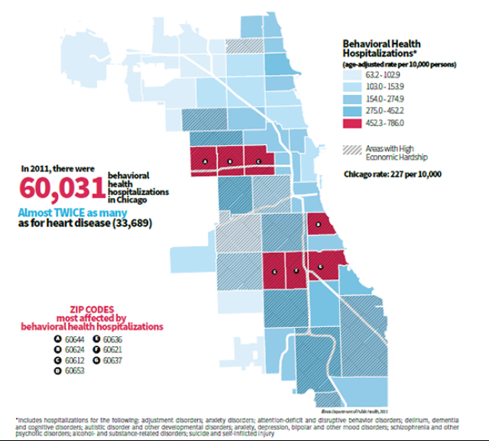
Chicago’s gun violence and shutting down of mental health clinics
In 2016, there were more than 4,000 shootings and 762 homicides in Chicago. Many of the perpetrators and victims are of the youth in Chicago and are apart of gangs.
In 2011, there were 60,031 behavioral health hospitalizations as well, almost 2x as many for heart disease.
Meanwhile, since 2009, the city has closed six mental health clinics and the state cut $113.7 million in funding for mental health services,
This means there will be a decrease of mental health providers/counselors

Slide 29
Physicians attitudes and behaviors about issues relating to firearms
A team of UNC department of family medicine researchers and UNC School of Medicine students surveyed 223 physicians including psychiatrists, family physicians, and internists. The questionnaire addressed physician attitudes and behaviors about various issues related to firearm safety. The results found that:
80 percent of the physicians agreed or strongly agreed that gun violence is a serious public health issue that should be included in medical training.
Only 25 percent of those surveyed reported having conversations with patients about firearms or firearm safety often or very often, and almost half reported not asking depressed patients if they had a firearm in their home.
Notes:
physician gag law(florida) is a law that prohibits physicians from asking their patients about whether the patient owns a gun. In some cases, these laws may also restrict the ability of physicians to counsel their patients about gun safety

Slide 30
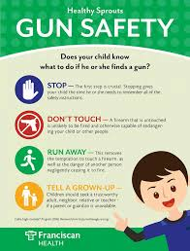
Barriers to Firearm Safety Counseling
The American Academy of Pediatrics recommended that physicians provide counseling for firearm safety in youth. There are a number of major barriers to screening for and intervening with gun violence and mental health disorders for youth in the health care settings.
Lack of time to screen multiple health areas
Feeling uncomfortable raising sensitive issues
May feel firearm counseling is outside their scope of practice.
State specific laws
Could interfere with patients second amendment rights- right to bear Arms
Lack of confidence and self-efficacy in managing issues with young people
Notes:
physician gag law(florida) is a law that prohibits physicians from asking their patients about whether the patient owns a gun. In some cases, these laws may also restrict the ability of physicians to counsel their patients about gun safety

Slide 31
Solution for gun violence among youths
Gun violence has been a sinister threat to youths. Series of events occur among the youth that calls for an urgent need to find solutions. Events and of gun violence among the adolescents’ calls for appropriate action from public health care providers.
Solving gun violence through research
Research on the effects of exposing children to guns and how this can impact on gun violence when the children reach adolescence.
Research on gun violence might recommend coming up with policies that support safe storage of firearms and ensuring that they are kept out of the hands of the children and the youths.
Research will also indicate whether background checks will help in preventing accidental shootings.

Slide 32

Enactment of policies and regulations
Policies and regulations advocates for safe gun storage practices especially when it comes to keeping guns out of reach of children and firearm prohibition for high risk groups and individuals with mental challenges.

Slide 33
Establishment of all-inclusive health systems
The system is dedicated to a health and community response by developing a framework for addressing and preventing violence through incorporating other essentials such as public health departments, religious based institutions, justice systems and primary health care which ensures safety, health and equity.
Community healing
Prevention of community trauma and expansion of access to emotional and mental health support in order to address trauma that leads to gun related violence. Public health assess and connect individuals who are at a high risk to arm themselves.

Slide 34

Establishing a culture of gun safety
This involves educating and sensitizing the community on gun related violence. This incorporates public health facilities in identifying and raising emotionally healthy children and arbitrates with affected individuals who are threatening violence.

Slide 35

Summary
Guns are extremely prevalent in the US, and violence(whether seen or experienced) can cause many mental health consequences.
Thousands of people die as a result of gun violence every year. Children represent some of the most vulnerable groups to gun violence.
Policies regarding guns in the US differ from state to state, with a large emphasis on regulating “open-carry” according to the state’s jurisdiction..
American gun policies are relatively lax compared to other countries, perhaps owing to the 2-5 times greater rates of gun-related deaths in the United States compared to the rest of the developed world
Lack of research, Opposition from NRA, stigma, disparities, decreased access to mental healthcare as well as lack of firearm safety are all barriers to helping us understand this issue.
This is a multifaceted issue that can have many solutions, starting with policy change, counseling children and adolescents on violence, and providing the mental health services to those who have been affected by gun violence.

Slide 36
Sources-Intro
https://www.jstor.org/stable/pdf/1602739.pdf?casa_token=iqvbGcIlqNAAAAAA:KbGddYDK0bDzZEDJqmLD9oj9GrrlN8A29Ls5fo4lBUr60qIGQWoLndmi6DP2r5IoxENpHbxOkJzNMKlxd3XmRtwTsl2qxeW6AQtdWB1ZUJG7joheRPp9
https://www.nytimes.com/2018/12/18/us/gun-deaths.html
-https://www.jstor.org/stable/pdf/1602741.pdf?casa_token=OuzF221eN0EAAAAA:aPnu2rgAXhKu8IwIMb8nt5mnsvqqtXPS3ioeP0oIy4Guo8dLDfFiz8ShpdFkqG64VxhwD95OwjiNxVRyjcSluxA3n9IkpVVDYfZP_oznl9fRunEuu30v
https://www.healthaffairs.org/doi/full/10.1377/hlthaff.12.4.7 -
https://www.apha.org/~/media/files/pdf/factsheets/160317_gunviolencefs.ashx
https://www.cdc.gov/nchs/pressroom/sosmap/firearm_mortality/firearm.htm

Slide 37
Sources- Gun policies in the US
https://www.ncbi.nlm.nih.gov/pmc/articles/PMC5993413/
https://www.theatlantic.com/health/archive/2018/02/gun-violence-public-health/553430/
https://sciencebasedmedicine.org/gun-violence-as-a-public-health-issue/
https://www.americanprogress.org/issues/guns-crime/reports/2016/03/09/132894/removing-barriers-and-reinvesting-in-public-health-research-on-gun-violence/
https://www.vox.com/2016/6/15/11934246/gun-violence-america-questions
https://www.childtrends.org/wp-content/uploads/2013/04/Child_Trends-2013_01_01_AHH_MHAccessl.pdf
http://www.mentalhealthamerica.net/issues/mental-health-america-youth-data
https://www.ncbi.nlm.nih.gov/pmc/articles/PMC2945389/
https://www.ncbi.nlm.nih.gov/pmc/articles/PMC3731155/
http://news.unchealthcare.org/news/2018/january/majority-of-doctors-do-not-counsel-patients-about-firearm-violence
https://www.ncbi.nlm.nih.gov/pmc/articles/PMC5784421/
https://www.ncbi.nlm.nih.gov/pmc/articles/PMC4973106/
https://www.businessinsider.com/how-to-buy-a-gun-2017-10

Slide 38
Sources-Policies around the world
https://www.law.cornell.edu/wex/second_amendment
https://lawcenter.giffords.org/gun-laws/policy-areas/guns-in-public/open-carry/
https://www.standard.co.uk/news/world/us-gun-control-laws-who-can-own-a-gun-how-do-americas-firearms-regulations-work-a3768231.html
https://www.thoughtco.com/who-cannot-have-gund-in-america-4051068
https://www.gunstocarry.com/federal-gun-laws/

Slide 39
Sources-Breaking down barriers
https://www.cfr.org/backgrounder/us-gun-policy-global-comparisons
https://www.pbs.org/newshour/politics/gun-policy
https://www.nytimes.com/interactive/2018/03/02/world/international-gun-laws.html
https://www.thoughtco.com/who-cannot-have-gund-in-america-4051068
https://www.thetrace.org/2016/07/rise-of-open-carry-explained/

Slide 40
Sources-Breaking down barriers
http://annals.org/aim/fullarticle/2522436/yes-you-can-physicians-patients-firearms
https://www.pbs.org/newshour/health/chicagos-gun-violence-crisis-also-mental-health-crisis
https://www.preventioninstitute.org/focus-areas/preventing-violence-and-reducing-injury/preventing-violence-advocacy
https://www.rand.org/blog/rand-review/2018/07/more-research-could-help-prevent-gun-violence-in-america.html
https://injury.research.chop.edu/blog/posts/practical-solutions-preventing-youth-gun-violence#.XEY6d7mI_IU.
https://www.americanprogress.org/press/release/2018/05/04/450321/release-devastating-impact-gun-violence-americas-youth/

